Slide 1
“Applications for Procedural Patient Data Generation in Pathology Informatics”
Vektra Casler MD
8/20/2021

Slide 2
What is this project?
Procedural patient clinical testing data generator
Pseudo-random number generation to generate patient data fields
Choices are weighted
Weights are drawn from found data sources (where possible)
Mathematical formulae for probability distributions where weights are unavailable (normal curve distribution)
Simulates a patient population which undergo clinical testing over various analytes and aggregates that data into a large flat-database structure

Slide 3
Why did I create this project?
Health data is protected to minimize patient risk.
Laws prevent unethical use or exposure of patient data, such as Health Insurance Portability and Accountability Act (HIPAA).
Health care investigators have restricted access to patient data for testing or research purposes.
Paradox Results: Difficult to prepare for the data they’re attempting to investigate, without having previously encountered the data.
This project removes this risk because all patient data is synthetic

Slide 4
Who is this project for?
Anyone interested in data science investigations in healthcare
Investigators needing unprotected data to design data-processing scripts and pipelines
Students wishing to learn more about data science investigation
Data science instructors needing synthetic data files for designing lesson plans

Slide 5
How will this project help?
Synthetic data absolutely removes any risk of patient identification.
“De-identified” data can sometimes still be traced back to patients.
Specimen photos are a big risk
Procedural data generation has no associated patient.

Slide 6
What can people do with this synthetic data?
Example projects include:
Testing usage studies for assessing 'break-even' points in cost analysis.
Investigate timestamps to assess bottlenecks or behaviors.
Ordering quality studies for assessing clinician performance and ordering habits.
Investigate correlations between patient diagnoses and clinical values.
Construct clinical investigatory pipelines in preparation for actual data.
Bolster AI training pools with "true negative" data, minimizing the need for pulling real patient data.
Facilitate AI quality control or validation studies.
Build dashboards for any of these investigations.
Organize learning modules for trainees around assessing data and various quality metrics (L-J plots, Youden charts, etc.)

Slide 7
Who else is currently doing this?
Surprisingly few
Washington University School of Medicine in St. Louis (MDClone)
Focuses on clinical encounter data (EMR level?)
Have published a few papers on their validation methods and AI tool creation
Hand-crafted synthetic data pools exist
Some de-identified patient data can also be found
https://informatics.wustl.edu/mdclone/

Slide 8
How did you create this project?
Project is written in Python Programming Language
Pandas module : flat data structure manipulation
‘random’ module : generates random numbers using computer clock
‘math’ module : for designing mathematical probability distribution functions
Knowledge of previous informatics projects to recall which data fields to generate
“Found” data sources from across the internet
www.python.org/

Slide 9

How did you model the data generation? (1/7)
A list of ‘people’ is generated
Demographics are chosen according to population distributions (age, race, sex)
Names are generated using found data (lists of names by year, last names by prevalence)
Unique SSN and MRN numbers are generated

Slide 10


How did you model the data generation? (2/7)
Providers are chosen from the pool
Providers are assigned a specialty
Providers are given a degree (RN, PA-C, MD/DO)
Provider numbers are generated (according to CMS structuring)
Primary care office addresses and phones are assigned

Slide 11

How did you model the data generation? (3/7)
Hospital Systems are modeled
Generated buildings include
Hospitals (with beds that are contributed to the pool)
Floors/wards are separate within the hospital
Laboratories
Outpatient Clinics (with draw stations)

Slide 12
How did you model the data generation? (4/7)
All patients are assigned primary care physicians from the provider list
Beds are filled with patients up to portion of capacity (variable)
Patients are given a diagnosis (ICD-10) and admission timestamp
A portion of remaining patients are chosen for outpatient draws that day (variable ratio)
<Simulation begins>

Slide 13



How did you model the data generation? (5/7)
Orders are generated with order numbers, locations, and timestamps
Inpatients receive a number of draws per day (variable, 1-4)
Chosen outpatients are likewise drawn (once)
Samples are given specimen numbers and timestamps for draws

Slide 14

How did you model the data generation? (6/7)
Timestamps are generated for arrival, processed, and resulted
Tests are chosen by probability weights
Results are generated (normal curve distribution)
Testing record is appended to the flat database file (CSV)

Slide 15

How did you model the data generation? (7/7)
The date advances
A portion of patients are discharged, vacating beds which are added back to the pool
A portion of patients are transferred to different floors/wards
Beds are filled back up to a portion of capacity (fluctuates)
New outpatients are chosen
The cycle repeats until the specified number of records is reached

Slide 16
Which data sources did you use?
DEMOGRAPHIC DATA
https://www.census.gov/prod/cen2010/briefs/c2010br-03.pdf
https://www.census.gov/quickfacts/fact/table/US/PST045219
https://www.census.gov/quickfacts/fact/note/US/RHI625219
https://geographic.org/streetview/usa/index.html
https://www.healthit.gov/isa/uscdi-data-class/patient-demographics#uscdi-v1
https://blog.splitwise.com/2013/09/18/the-2010-us-census-population-by-zip-code-totally-free/
https://www.ssa.gov/oact/babynames/names.zip
https://namecensus.com/most_common_surnames.htm
TEST ORDERING DATA
https://www.cms.gov/Medicare/Coding/ICD10/2020-ICD-10-CM
https://www.aamc.org/data-reports/workforce/interactive-data/number-people-active-physician-specialty-2017
https://www.ahrq.gov/research/findings/factsheets/primary/pcwork3/index.html
https://loinc.org/downloads/loinc-table/
LAB VALUE DATA
URMC internal documents
Tietz Manual of Chemistry
MISCELLANEOUS DATA
https://email-verify.my-addr.com/list-of-most-popular-email-domains.php
https://www.pewresearch.org/internet/fact-sheet/mobile/#:~:text=Mobile%20phone%20ownership%20over%20time,a%20cellphone%20of%20some%20kind.
https://www.statista.com/chart/2072/landline-phones-in-the-united-states/
https://en.wikipedia.org/wiki/List_of_North_American_Numbering_Plan_area_codes
https://en.wikipedia.org/wiki/Telephone_prefix#United_States_prefixes

Slide 17
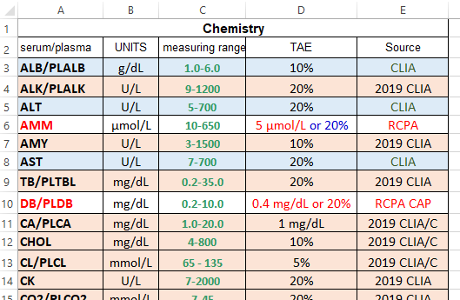

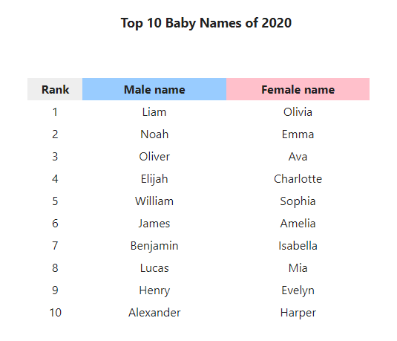
Example Data Sources
Internal URMC documents
www.ssa.gov/OACT/babynames/

Slide 18
What data does this project generate?
PATIENT
-------
name
surname
middle_name
name_suffix
age
race
ethnicity
social_security_number
date_of_birth
medical_record_number
street
city
county
state
zip
cell_phone
home_phone
work_phone
email
ENCOUNTER
---------
patient_type [inpatient, outpatient]
icd_10_code
encounter_timestamp
SPECIMENS
---------
specimen_type [whole_blood,serum,plasma,urine,CSF,etc]
specimen_id
drawn_timestamp
received_timestamp
processed_timestamp
resulted_timestamp
ORDERS
------
test_name
test_LOINC
ordered_timestamp
patient_location
order_id
PROVIDERS
---------
ordering_provider_name
ordering_provider_id
ordering_provider_type
ordering_provider_specialty
ordering_provider_location
LAB DATA
--------
lab_name
lab_site_id
lab_address
test_result
threshold_low
threshold_high
critical_flag
units

Slide 19
What are some features of this data?
Real-world found data used (as frequently as is possible)
Weighted choices help produce more ‘realistic’ data
Healthy patients are modelled
Generated lab value will follow normal curve distribution
Alternate probability distribution curves exist for some labs
Inverse relationship
Surge function mapping
Normal curves with massive skew or kurtosis variability

Slide 20
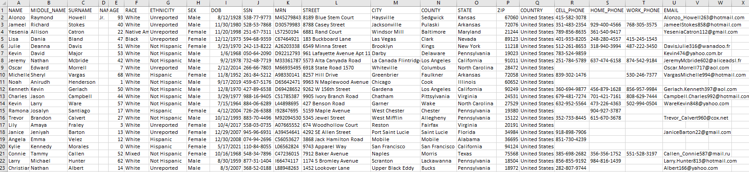
How does this synthetic data compare to real data?
So far, pretty well, allowing for statistical variation.
Eventually, AI analysis between this synthetic data and real data should be performed.

Slide 21
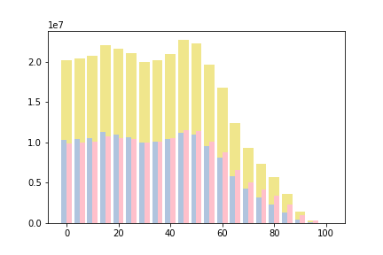
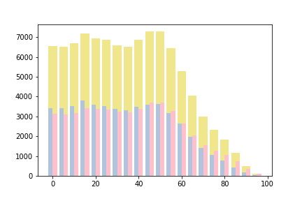
How does this synthetic data compare to real data?
Patient Ages – 2010 Census Data
Patient Ages - Procedural Generated Data

Slide 22
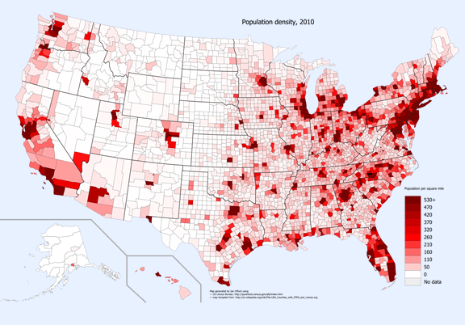
How does this synthetic data compare to real data?
Placeholder
Graphic
Chloropleth – 2010 Census Data
Chloropleth - Procedural Generated Data

Slide 23
What are some limitations of this synthetic data?
Only healthy population data is generated
By design: results are specifically within the normal range (with 5% deviation) to provide “true negative” data
No disease process bias is present in this procedural generation
By design and necessity: Instituting and maintaining factual biases in this procedural data generation would require monumental effort equal to medicine itself
Reliant on found internet sources
Reputability is variable
Other specific project scope limitations
USA addresses only, imperial units, diminishing returns on some demographics

Slide 24
How will you distribute this data generation tool to other users?
Currently, Github (www.github.com)
Project version tracking website
Files can be made public, allowing anyone to download and use
Public use tracking tools here are limited
Eventually, some sort of website which can track user interaction.
Hosted on UR site? (like MDClone at Washington University)

Slide 25
How will you support this project long term?
Unsure. I am open to suggestions.
If this project is supported by a collaboration with UR or RIT, perhaps data science students could maintain it as part of their education?
Refactoring to different programming languages may be necessary.
Relational database structures, such as SQL, may benefit the project
Javascript is helpful in web portal creation

Slide 26
What features do you wish to add to this project?
More data fields
90K procedure codes exist (LOINC) – What other healthcare testing could be generated?
Heart rhythm tracings?
NGS pipeline data?
Graphical data (radiological imaging)?
Optional data flags – Generate different types of data for software/script error testing.
Missing/Null values (such as for cancelled or open/unresulted orders)
Non-standard characters in fields
‘Data dirtying’ routines to test data munging/wrangling scripts

Slide 27
What features do you wish to add to this project?
Data field toggles
Deactivate unnecessary data fields to economize file size
HL7 message streaming
Translate generated data into HL7 messages to test internet traffic capturing

Slide 28
Further Questions
How does this project promote the scientific community?
Provides a tool for investigating data correlation
Is this actually research?
I’m not really sure yet.
How can this be made into research?
Tracking usage – Survey users of this data tool to see how they intend to use it
????

Slide 29
Where might you publish this?
Journals which focus on quality improvement:
Archives of Pathology and Lab Medicine
Journal of Clinical Pathology
Journals which focus on AI tools:
Journal of Machine Learning Research
Journal of Artificial Intelligence Research
IEEE Transactions on Neural Networks and Learning Systems
Journals which focus on informatics:
Journal of Pathology Informatics
Journal of the American Informatics Association

